Slide 1
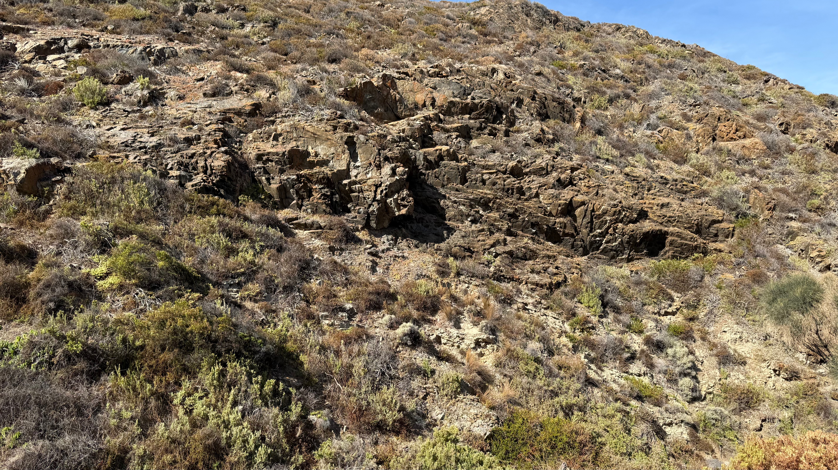
AG 10 – XMG meeting 2025-05-21T01:00
ISO/TC 211 60th Plenary meeting (Wuhan)
Bleys EJ, Co-convenor AG10
Spears T, Co-convenor AG10
EJBleys@gmail.com
2025-04-09
N 66

Slide 2
(2a) Before we start ISO Code of Ethics and Conduct

Slide 3

What and why?
This Code sets out principles for the conduct of persons acting for or on behalf of ISO, i.e. individuals representing ISO members, ISO governance groups and their members, the ISO standards development community, including liaison organizations, and the Central Secretariat (ISO/CS). - us.
The goal is that our deliverables benefit the international community over and above the interests of any individual or organization.
ISO Code of Ethics and Conduct

Slide 4

All ISO actors must uphold and respect the Code of Conduct
ISO Central Secretariat (ISO/CS)
National standards bodies (NSBs)
Individuals representing those member bodies
ISO committee chairs, committee managers, working group (or any established consensus group under a committee) convenors, WG secretaries, project leaders
Delegates and experts, including liaisons

Slide 5
Principles As individuals engaged in activities within the ISO system, we adhere to the following principles:
Comply with legal and statutory obligations
Perform and act in good faith, consistent with the purpose, policies and principles of the organization
Behave ethically
Promote and enable all voices to be heard
Engage constructively in ISO activities
Declare actual and potential conflicts of interest and manage them appropriately
Protect confidential information
Protect ISO assets
Avoid and prevent any form of bribery or corruption
Escalate and resolve disputes and uphold agreed resolution
Notes:
Same as before: 3
Slightly extended: 10
Reworded: 5
The others were all in the directives?

Slide 6
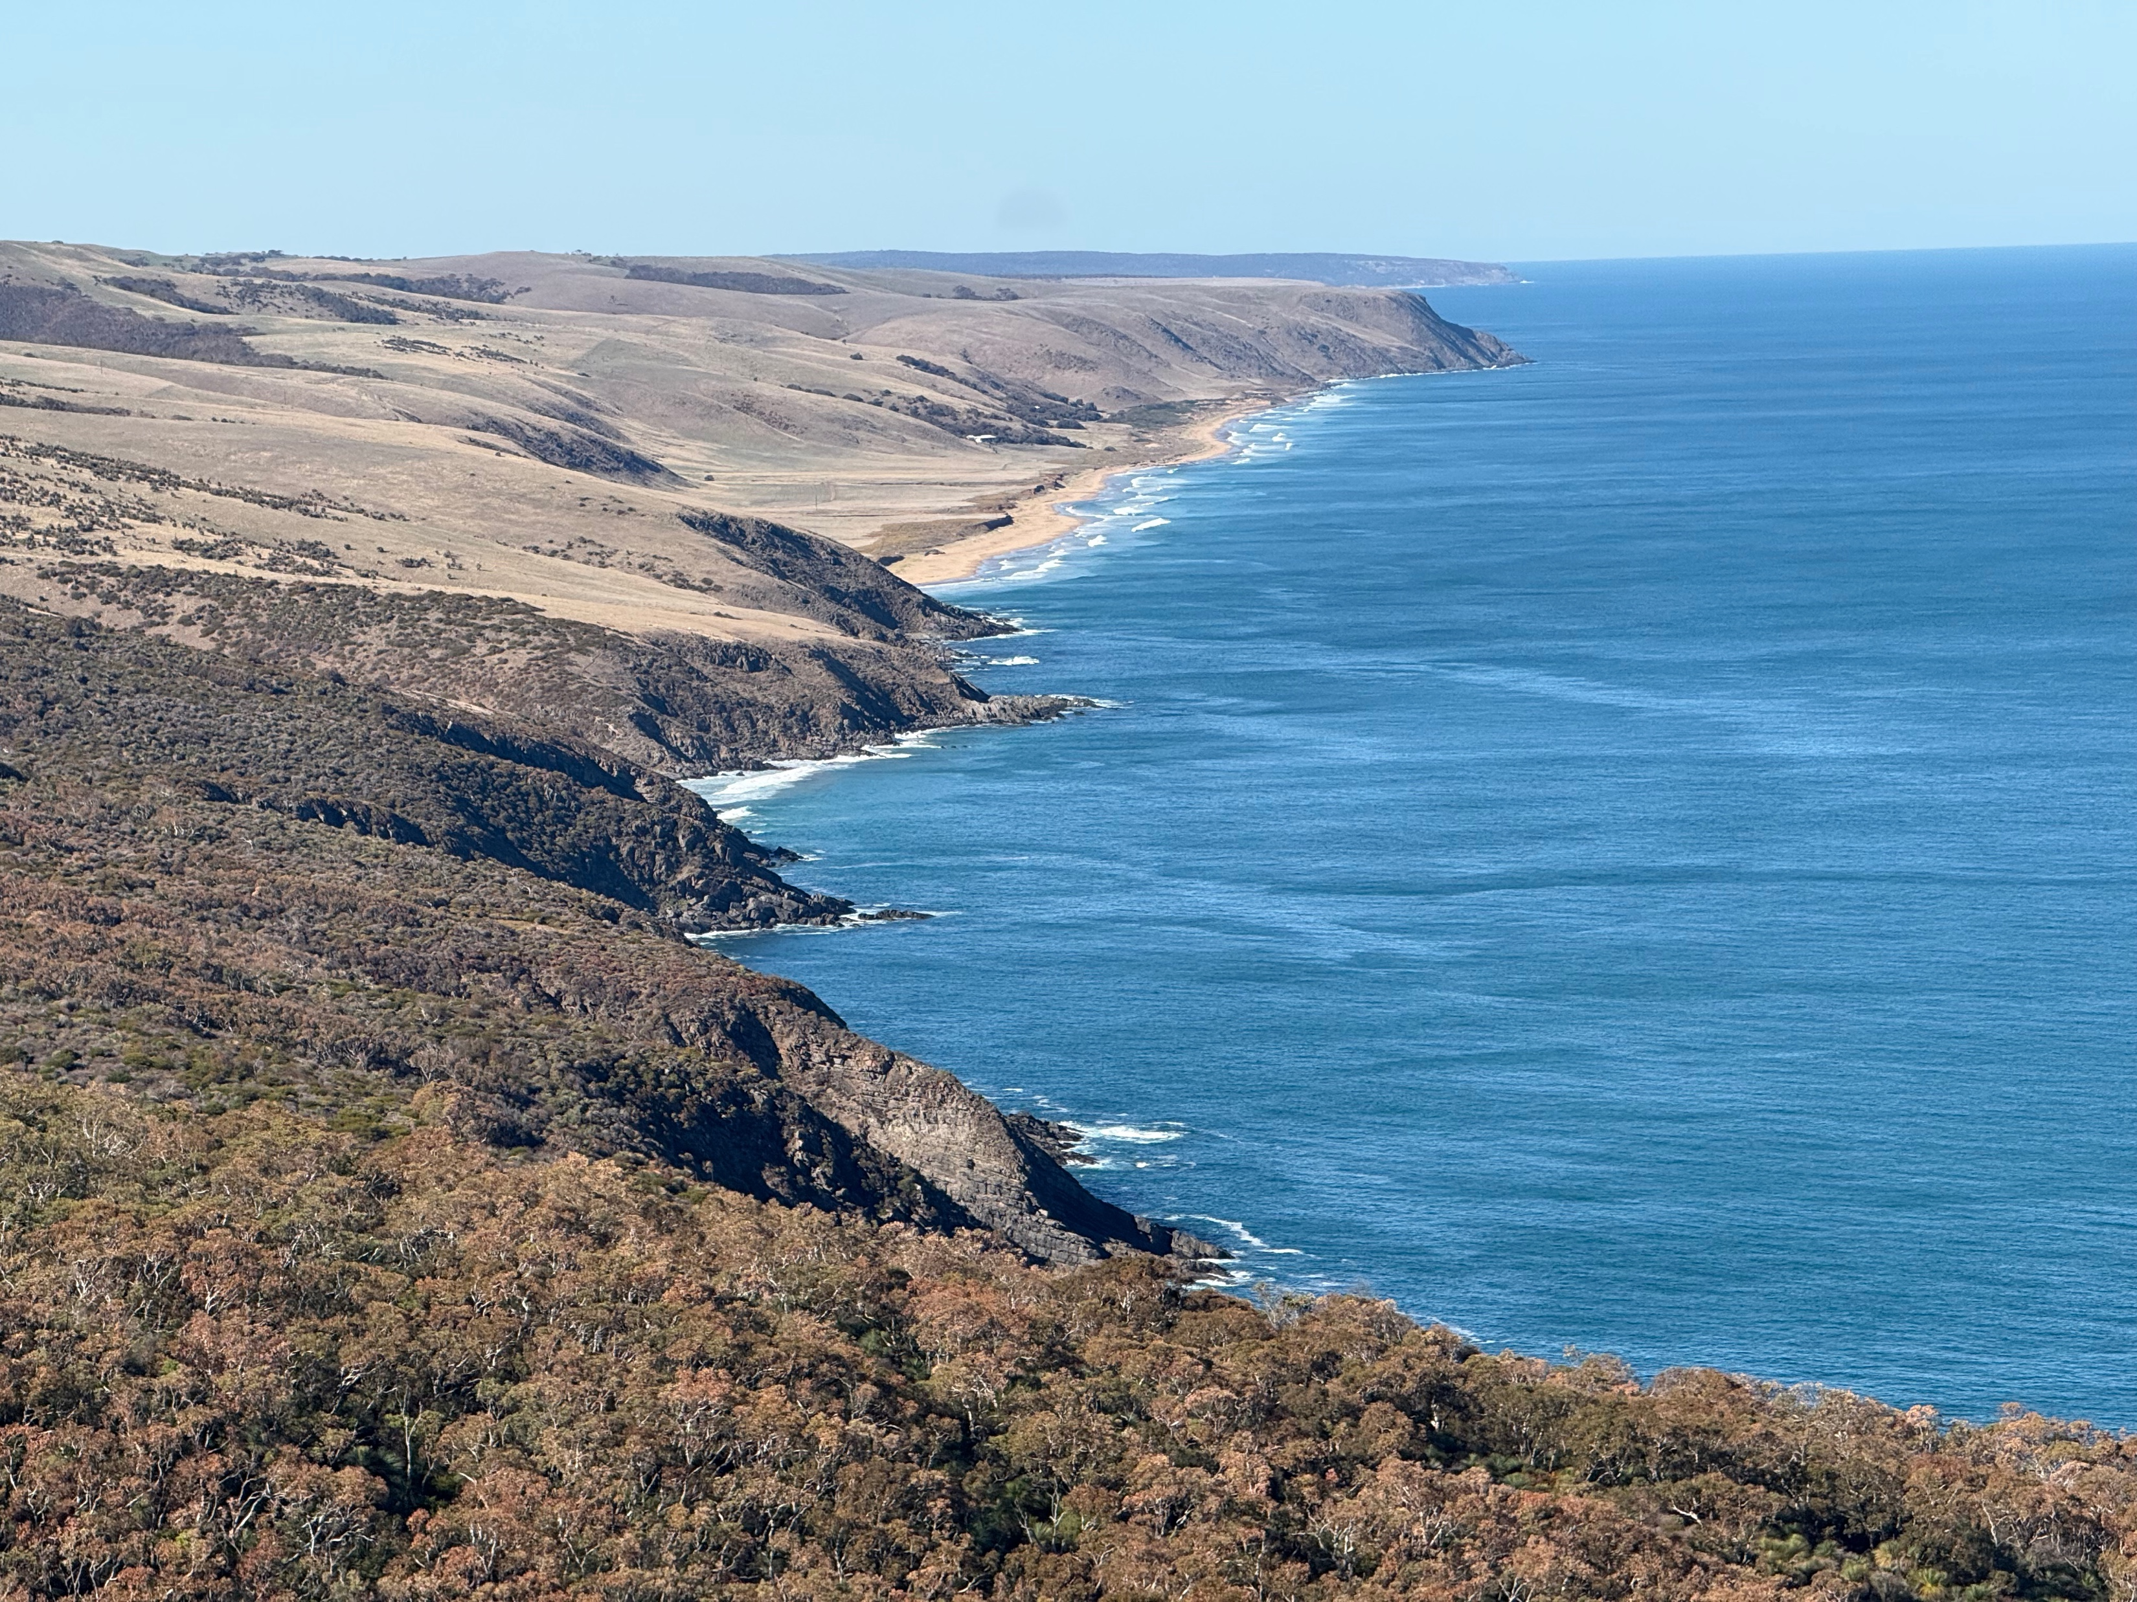

ISO/TC211
Geographic information/Geomatics
Standardization in the field of digital geographic information.
AG 10 – XMG meeting 2025-05-21T01:00

Slide 7
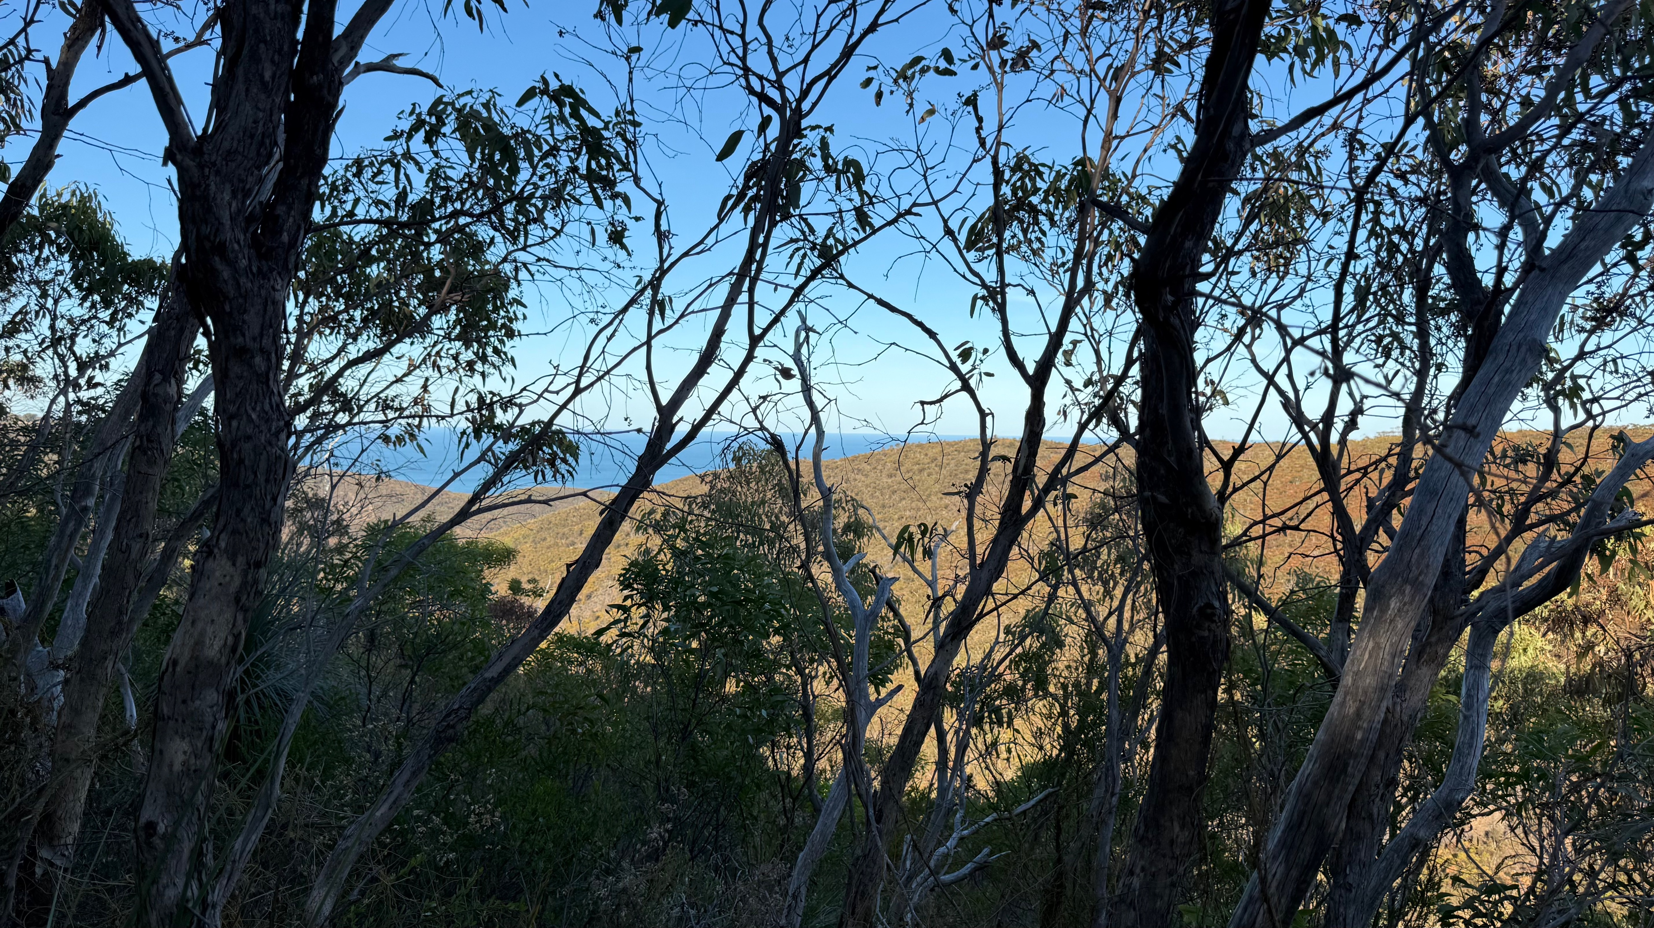
ISO/TC 211: AG 10 Scope
The XML Maintenance Group was established at the Quebec plenary in November 2009.
The XMG shall ensure that the ISO/TC 211 XML is collected, maintained and made accessible.

Slide 8
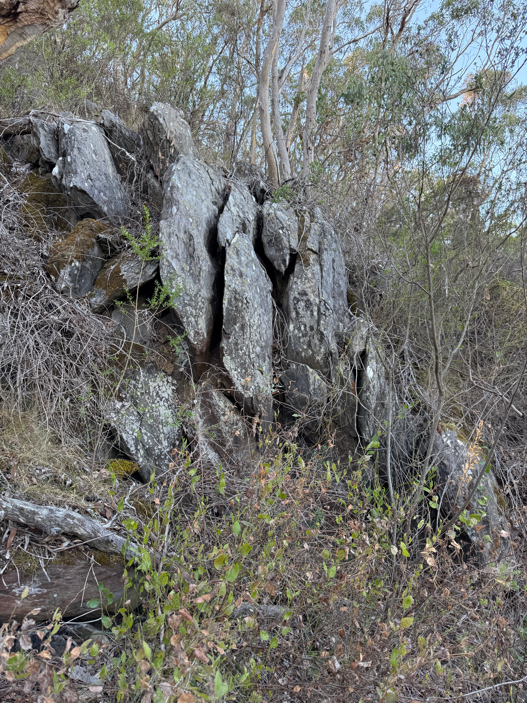
(2b) Roll call!
Roll call
Online
In the “Chat” window, please add your:
Name; Nominating organization; Country; & Email address.
Online behavior
Please mute your microphone
(except when speaking)
Please turn your video off
(saves bandwidth for people on problematic networks)

Slide 9
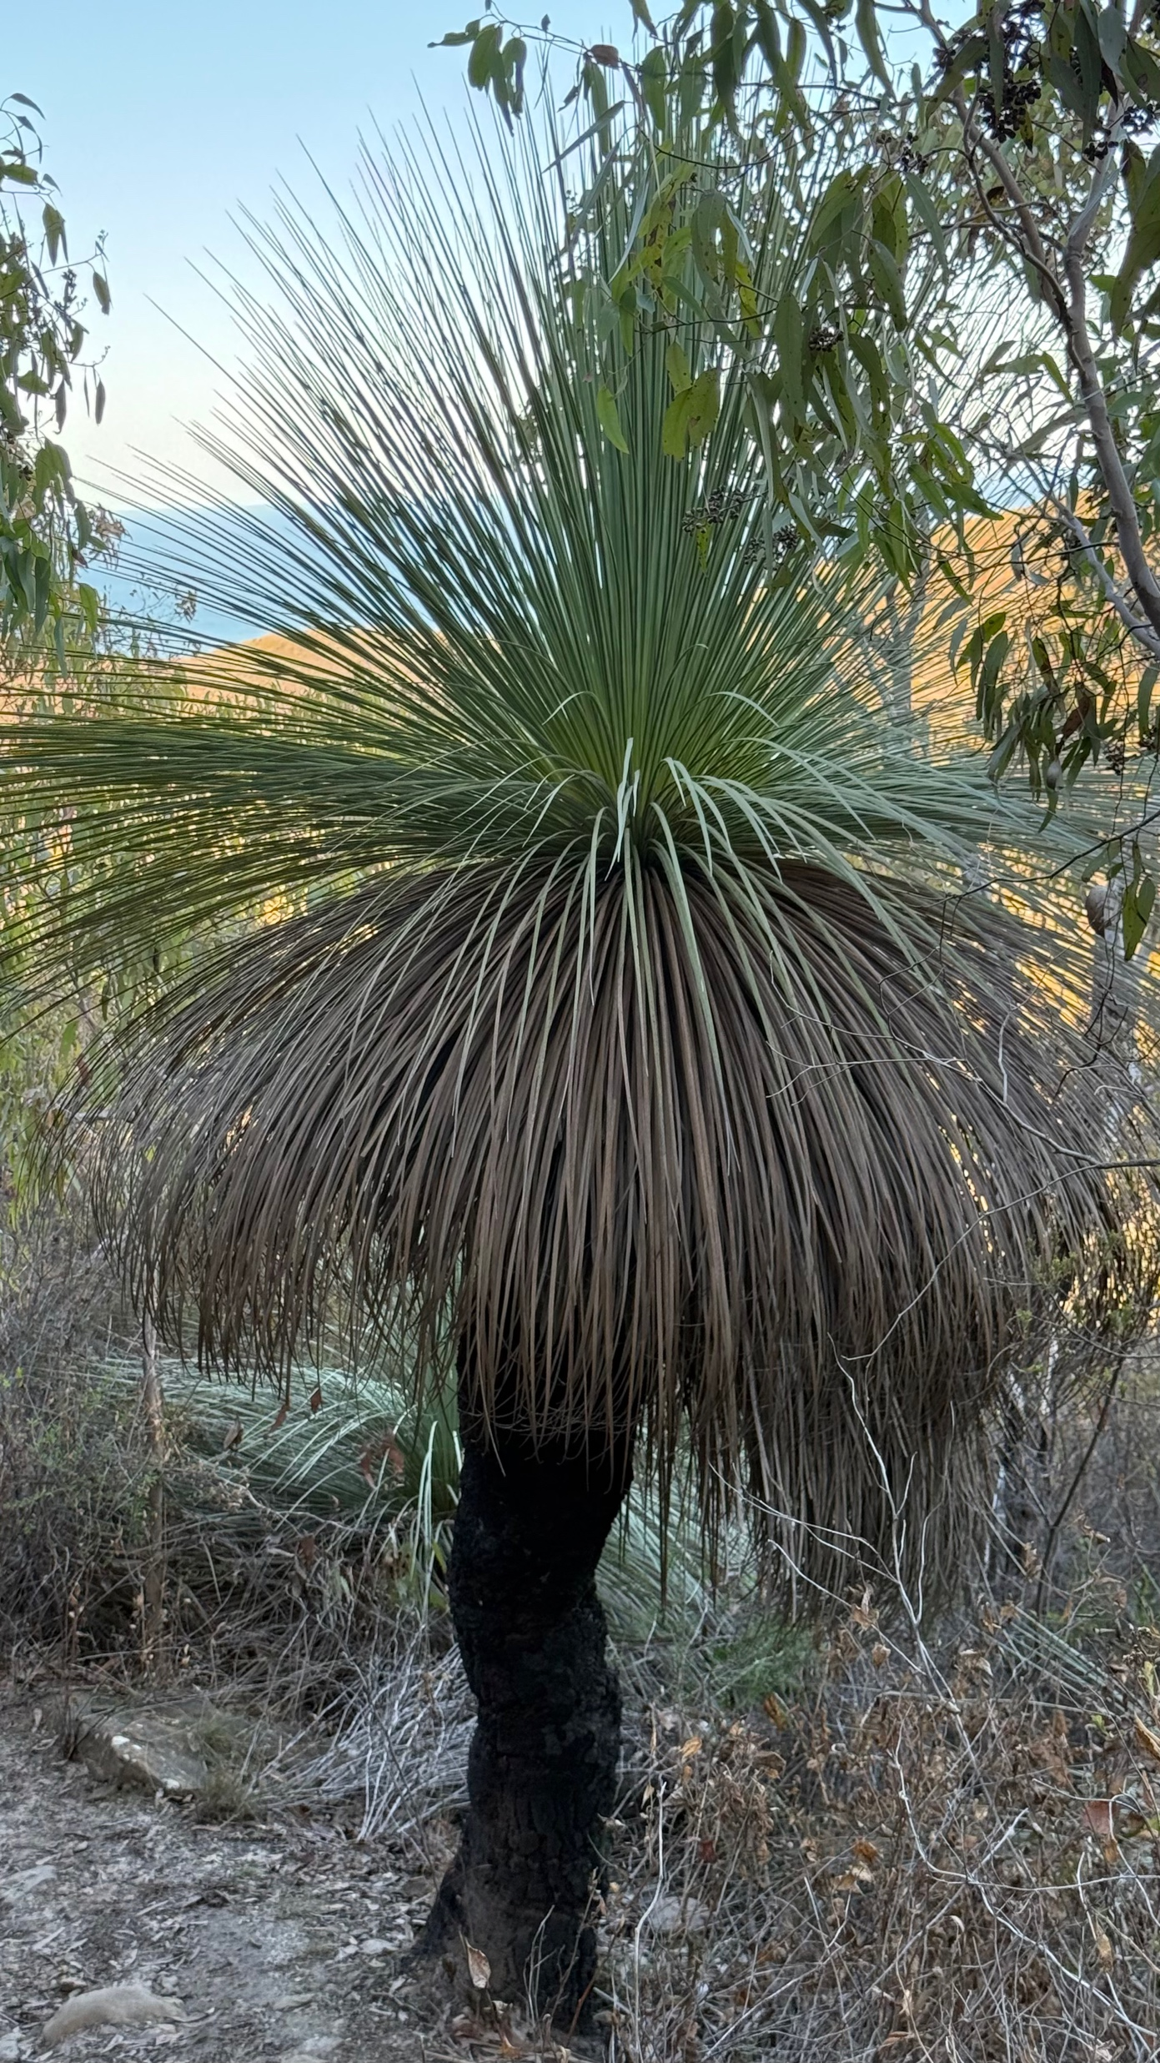
(3) Agenda
 | Agenda item | Action | Lead
1. | Opening of the meeting 2025-05-21T01:00 |  | Convenor
2. | Code of Conduct Roll call of delegates |  | Members
3. | Adoption of the [amended] draft agenda Doc. ISO/TC 211/AG 10 N68 |  | Members
4. | Issues from Standards Tracker | Recap
5. | Outcomes of mid-term meeting 2025-04-09
5.1 | Managing both XML and JSON schemas in the same repository | Discussion | Convenors
5.2 | Correcting XML files to comply with ISO 19139-1:2019 Clause 7.3.5.2 | Discussion | Convenors
6. | Watch and act: recently initiated projects | For Info
6.1 | Review of ISO 19115-1 Metadata – Fundamentals | For info
6.2 | ISO TR 19181 Maintenance and management of common classifiers and their implementation artifacts | For Info
7. | Any other business | Discussion | Members
 | Closure of the meeting () |  | Convenor

Slide 10
(4) Standards Tracker
No new items that need to be addressed
One shifter to ISO 19115-1 review
Items that didn’t make the tracker
XML “codeList” attribute not URL
Dealt with but upload failed???

Slide 11
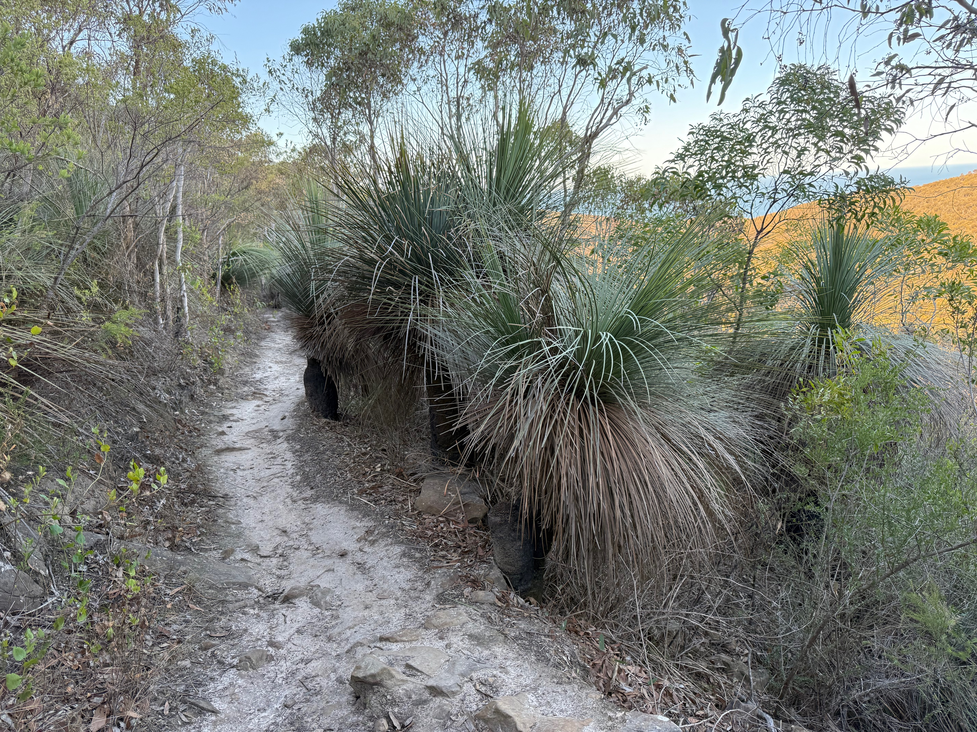
(5.1) Managing both XML and JSON schemas
in the same repository

Slide 12
Three (3) easily identified options One chosen
From: ISO/TC211 Good Practice Guide: Structure of URIs in ISO/TC 211 resources for implementation
XML Schema location:
https://schemas.isotc211.org/ ~
standardNumber/-[partNumber]/namespace/editionNumber.majorSchemaReleaseNo.minorSchemaRevisionNo/filename
Name | What it might look like | Issues
Separate trees | For JSON: https://schemas.isotc211.org/json/... For XML: https://schemas.isots211.org/xml/... Or https://schemas.isotc211.org/... | What to do with existing XML files? Might possibly leave XML path unchanged (Or)?
Same tree with divergence | For JSON: https://schemas.isotc211.org/191##/-#/json/abc/#.#.#/ijkLmn[.xyz[a]] Or https://schemas.isotc211.org/191##json/-#/.../ijkLmn[.xyz[a]] For XML: https://schemas.isotc211.org/191##/-#/xml/abc/#.#.#/ijkLmn.xml Or2 https://schemas.isotc211.org/191##/-#/abc/#.#.#/ijkLmn.xml | What to do with existing XML files? Are JSON/XML namespaces the same? Might possibly leave XML path unchanged (Or2)?
Colocation | https://schemas.isotc211.org/191##/-#/abc/#.#.#/ijkLmn.[W3C extention] https://schemas.isotc211.org/191##/-#/abc/#.#.#/ijkLmn.xml | Are JSON/XML namespaces the same? This could easily leave XML path unchanged! Implications for updates (#.#.#)
Other option?

Slide 13
Separate tree for JSON already instigated
JSON Schema anticipated location:
https://schemas.isotc211.org/json/19115/-4/mdj/1.0.0/mdj.json
https://schemas.isotc211.org/json/19157/-1/dqc/1.0.0/dqc.json
Work space JSON Schema location:
https://github.com/ISO-TC211/XML/tree/master/schemas.isotc211.org/json/19115/-4/mdj/1.0.0/mdj.json
https://github.com/ISO-TC211/XML/tree/master/schemas.isotc211.org/json/19157/-1/dqc/1.0.0/dqc.json
Only ReadMe.txt exist in those locations (2025-05-05)
Separate tree for XML needs to be put forward as a resolution
Resolution would recommend developing a schema tree at:
https://schemas.isotc211.org/xml/... (does not exist [yet])

Slide 14
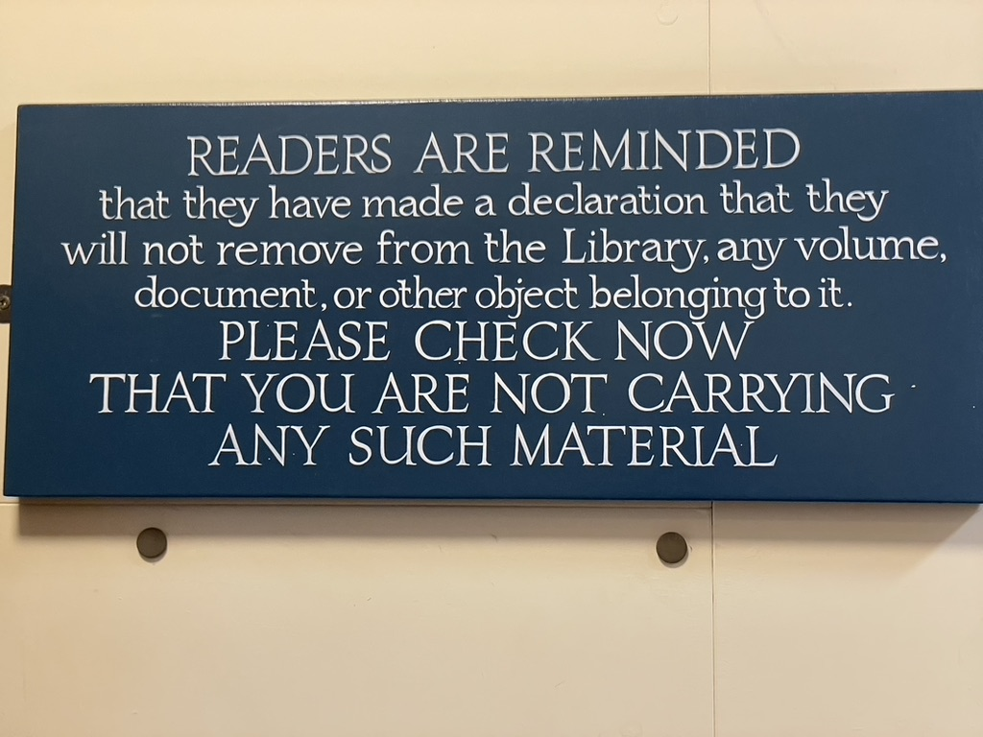

(5.2) Correcting XML records to comply with ISO 19139-1:2019 Clause 7.3.5.2
It is up to you to get it right, there is nobody checking!

Slide 15
ISO 19139-1:2019 Clause 7.3.5.2
“The codeList attribute is intended to contain a URL that references a codeList’s details, within a registry or a codelist catalogue”
A large number of XML elements have values for their codeList attribute pointing to:
Valid URIs
That are not resolvable as URLs
Invalid URLs
Files that don’t exist
Files that do exist but do not contain the required code set mentioned in the URL
Issue only occurs in XML records.
Most in codelist files
structured in accordance with the withdrawn 19139:2007
A few XML example files
Note: ISO 19103:2024 has retired the label “codelist” replacing it with “code set”

Slide 16
Tricky Codelists Code sets
The following codes are not stored in TC211 Code list/set files
Language codes
ISO 639
ISO suggests using USA Library of Congress listing
https://www.loc.gov/standards/iso639-2/langhome.html
Character set codes
Use http://www.iana.org/assignments/character-sets
Although there is a list of character sets in ISO 19115:2003 the set does not belong to ISO
Country codes
https://www.iso.org/obp/ui/#search/code/
seems to work (but URL drops “/code” on opening)
This ISO URL seems unlikely to be sustainable as it does not allow for other codes
https://countrycode.org
https://www.nationsonline.org/oneworld/country_code_list.htm
Which one to use? – Leave up to agency to decide/provide.

Slide 17
Repairing the damage
Version all the files
Note at start of existing file indicating that it has been retired and stating why
Note at start of new file indicating that it is a revision and stating the type of changes
Note with each bad URL
In retired file?
In revision file?
Note with each unresolvable URI
In retired file?
In revision file?
OR Version some files based on error
Not version files with only bad URLs
Fix URLs and move on
Version all files with unresolvable URIs
Note at start of existing file indicating that it has been retired
Note at start of new file indicating that it is a revision
Fix bad URLs (if any) and move on
With each unresolvable URI
State reason for revision
Comment out existing line
Insert replacement resolvable URL
How to version files? Possibly rename old so that existing external links continue to work.

Slide 18
Inserting text to explain changes
In existing files to be retired
<!-- File superseded to correct @codeList in line with ISO 19139-1:2019 Clause 7.3.5.2 "The codeList attribute is intended to contain a URL that references a codeList's details, within a registry or a codelist catalogue" -->
In replacement files
<!-- File updated to correct @codeList in line with ISO 19139-1:2019 Clause 7.3.5.2 "The codeList attribute is intended to contain a URL that references a codeList's details, within a registry or a codelist catalogue" -->
Replacing unresolvable URI with URL at each instance
<!-- LanguageCode@codeList updated in line with ISO 19139-1:2019 Clause 7.3.5.2 "The codeList attribute is intended to contain a URL that references a codeList's details, within a registry or a codelist catalogue" Library of congress used as it provides a logical URL as directed by ISO (https://www.iso.org/iso-639-language-code) --> <!-- <lan:language><lan:LanguageCode codeList="https://standards.iso.org/19115/-1/1/clause#B.3.11" codeListValue="eng">eng</lan:LanguageCode></lan:language> --> <lan:language><lan:LanguageCode codeList="https://www.loc.gov/standards/iso639-2/php/code_list.php" codeListValue="eng">eng</lan:LanguageCode></lan:language> AND
<!-- MD_CharacterSetCode@codeList updated in line with ISO 19139-1:2019 Clause 7.3.5.2 "The codeList attribute is intended to contain a URL that references a codeList's details, within a registry or a codelist catalogue" --> <!-- <lan:characterEncoding><lan:MD_CharacterSetCode codeList="https://standards.iso.org/19115/-1/1/clause#B.3.14" codeListValue="UTF8">UTF8</lan:MD_CharacterSetCode></lan:characterEncoding> --> <lan:characterEncoding><lan:MD_CharacterSetCode codeList="https://www.iana.org/assignments/character-sets" codeListValue="UTF8">UTF8</lan:MD_CharacterSetCode></lan:characterEncoding>

Slide 19
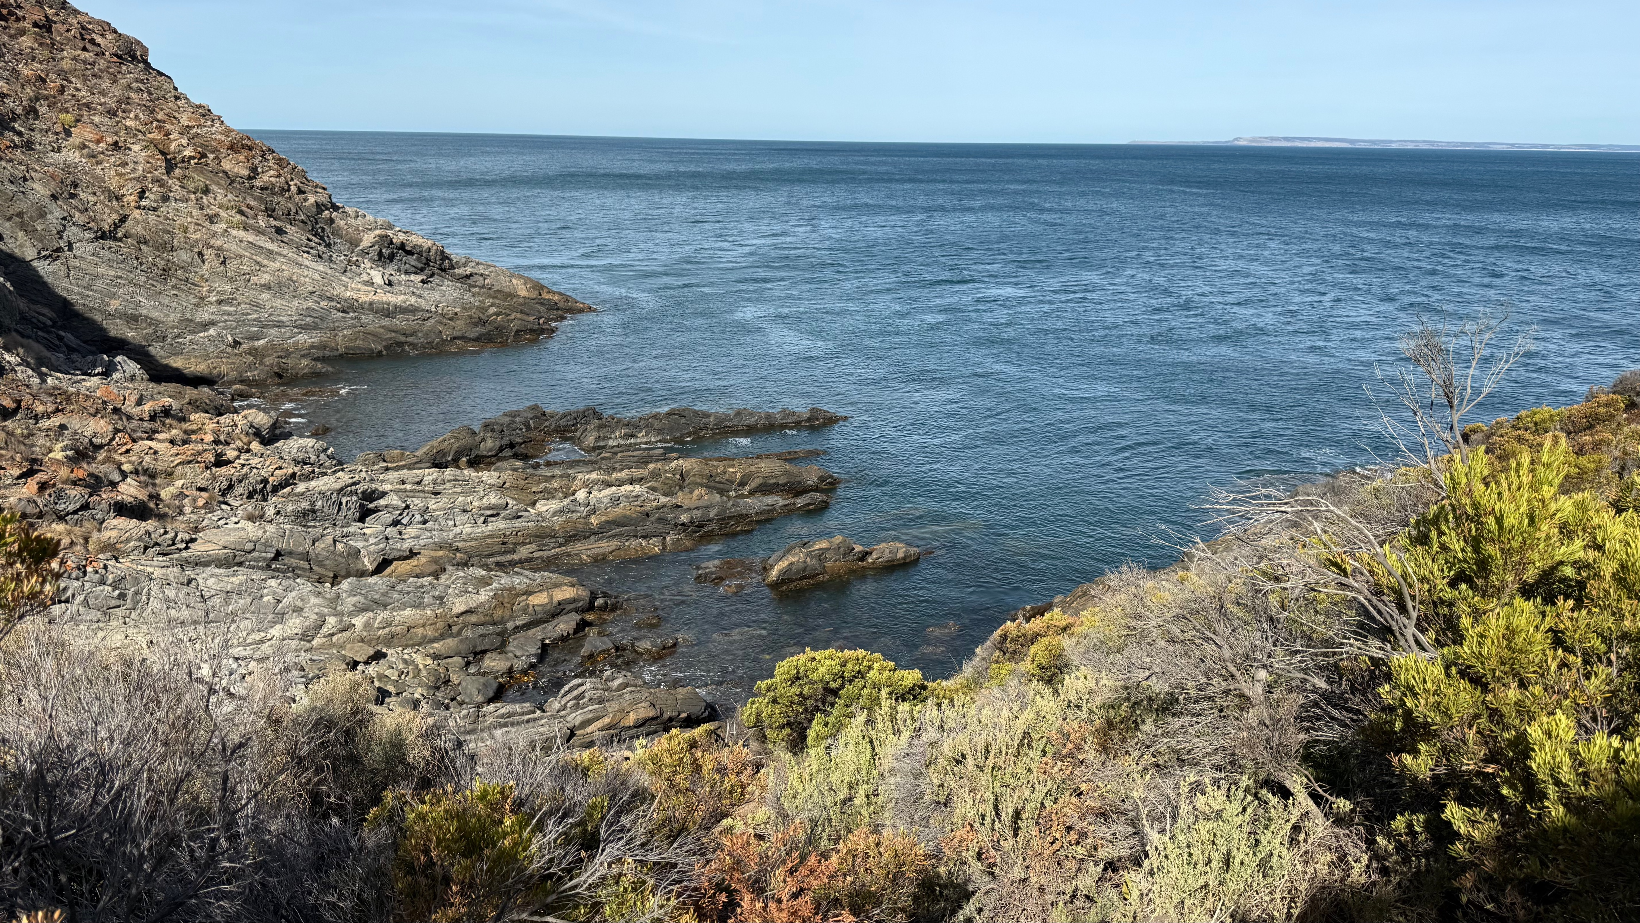
6.1 Review of ISO 19115-1 Metadata – Fundamentals

Slide 20
There will be XML schemas generated
Current practice in TC 211
Where there is an expectation that XML schemas will exist to allow implementation:
Those XML schemas will be facilitated by the project developing the Standard/Technical Report
The project can call on AG 10 and its members for assistance
Interactions with other ISO/TC 211 Standards / Technical Report
Implementation of new Standards need to navigate:
Implications of ISO 19103:2024 (and need for preservation of namespaces)
Potential recommendations of ISO TR 19181
WGs responsible for other Standards will need to decide if they wish to update the schemas to incorporate ISO 19115-1 changes
Such updates would be versioned so that the older schemas continue to exist and work without change.

Slide 21
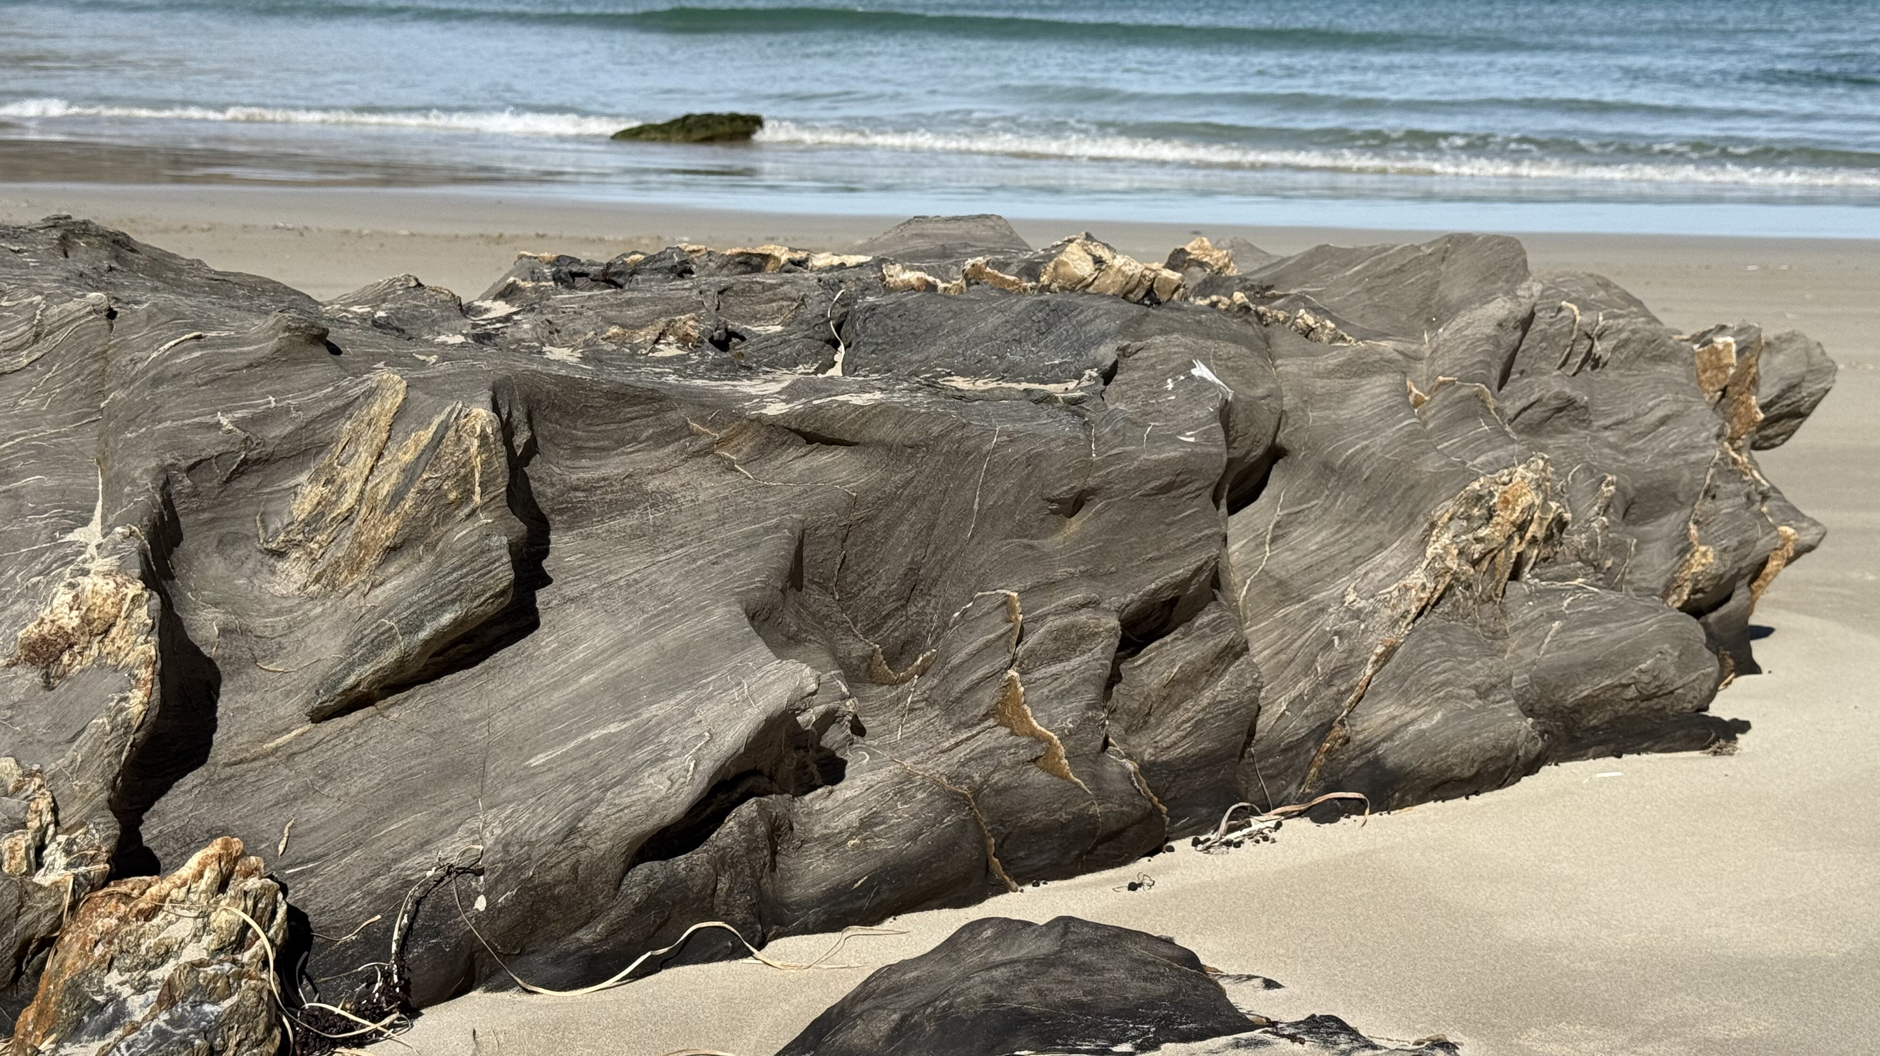
6.2 ISO TR 19181 Maintenance and management of common classifiers and their implementation artifacts

Slide 22
There will be XML schemas generated
Current practice in TC 211
Do not allow schemas to be places into a common space:
All schemas are currently associated with a Standard and include the number in the path
Schemas COULD be prepared in the GitHub XML workspace.
https://github.com/ISO-TC211/XML/tree/master/schemas.isotc211.org/xml/common
Interactions with other ISO/TC 211 Standards / Technical Report
Implementation of new Standards need to navigate:
Implications of ISO 19103:2024 (and need avoid namespace collisions)
Maybe new schemas to implement ISO 19103:2024 would not use “GCO”
HM uses Core Data Types for ISO 19103 Ed 2 so perhaps “CDT”
Potential recommendations of ISO TR 19181
WGs responsible for other Standards will need to decide if they wish to update the schemas to incorporate ISO 19115-1 changes
Such updates would be versioned so that the older schemas continue to exist and work without change.

Slide 23
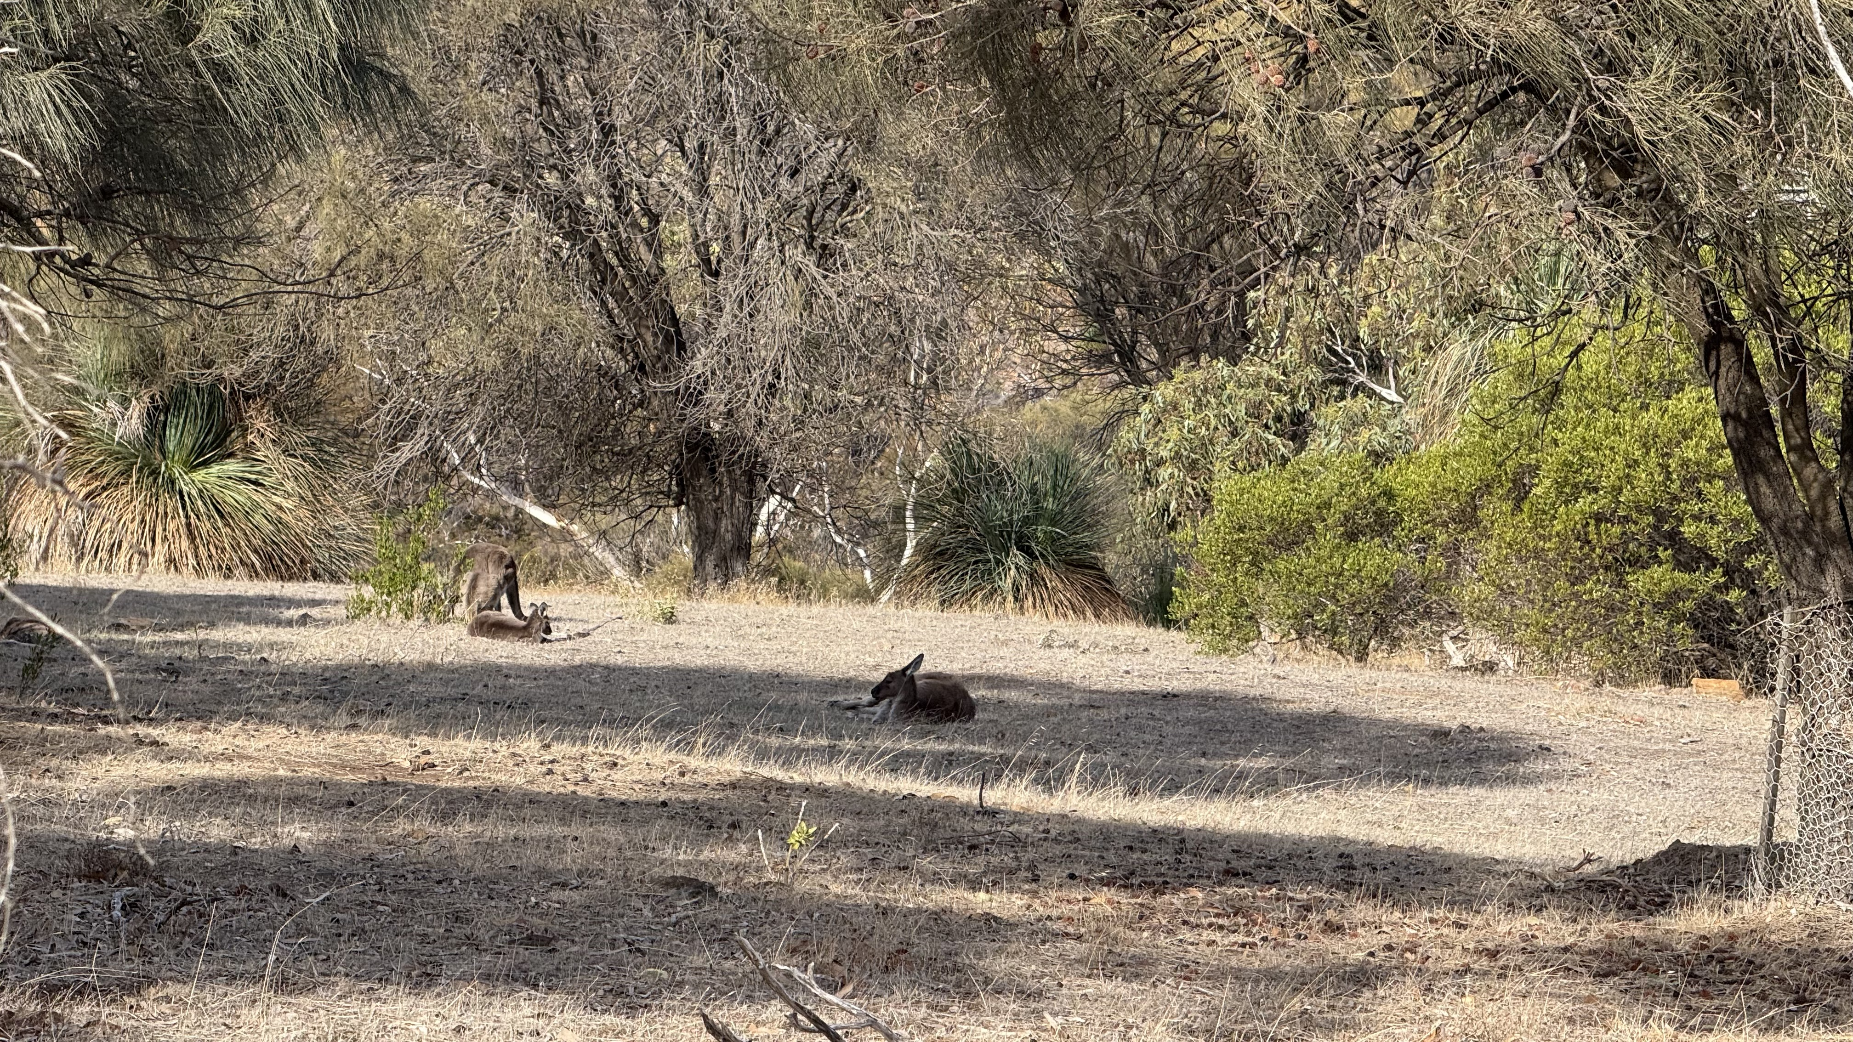
(7) Any other business?

Slide 24
Any other items for discussion?
Item | Discussion
Uploaded items not appearing in https://schemas.isotc211.org/schemas/ | Files loaded into GitHub schemas should flow on, but do not???

Slide 25
Potential resolutions
Item
ISO/TC 211 notes the introduction of JSON schemas into the schema repository with such schemas being accessible from a JSON branch within that repository with the root: https://schemas.isotc211.org/json/. ISO/TC 211 resolves to place XML schemas that have reference the ISO 19103:2024 Core Data Types in a branch of the repository with the root: https://schemas.isotc211.org/xml/ to parallel that for the JSON schemas. Noting the existing directories will continue to support those schemas that reference schemas that have implemented ISO 19103:2015. Furthermore, to avoid namespace conflicts, ISO/TC 211 resolves that the XML namespace prefix for elements that implement the Core Data Types as defined in ISO 19103:2024 will be “cdt”. The schemas implementing ISO 19103:2024, once developed, will be accessible from: https://schemas.isotc211.org/xml/19103/-/cdt/2.0.0/.

Slide 26
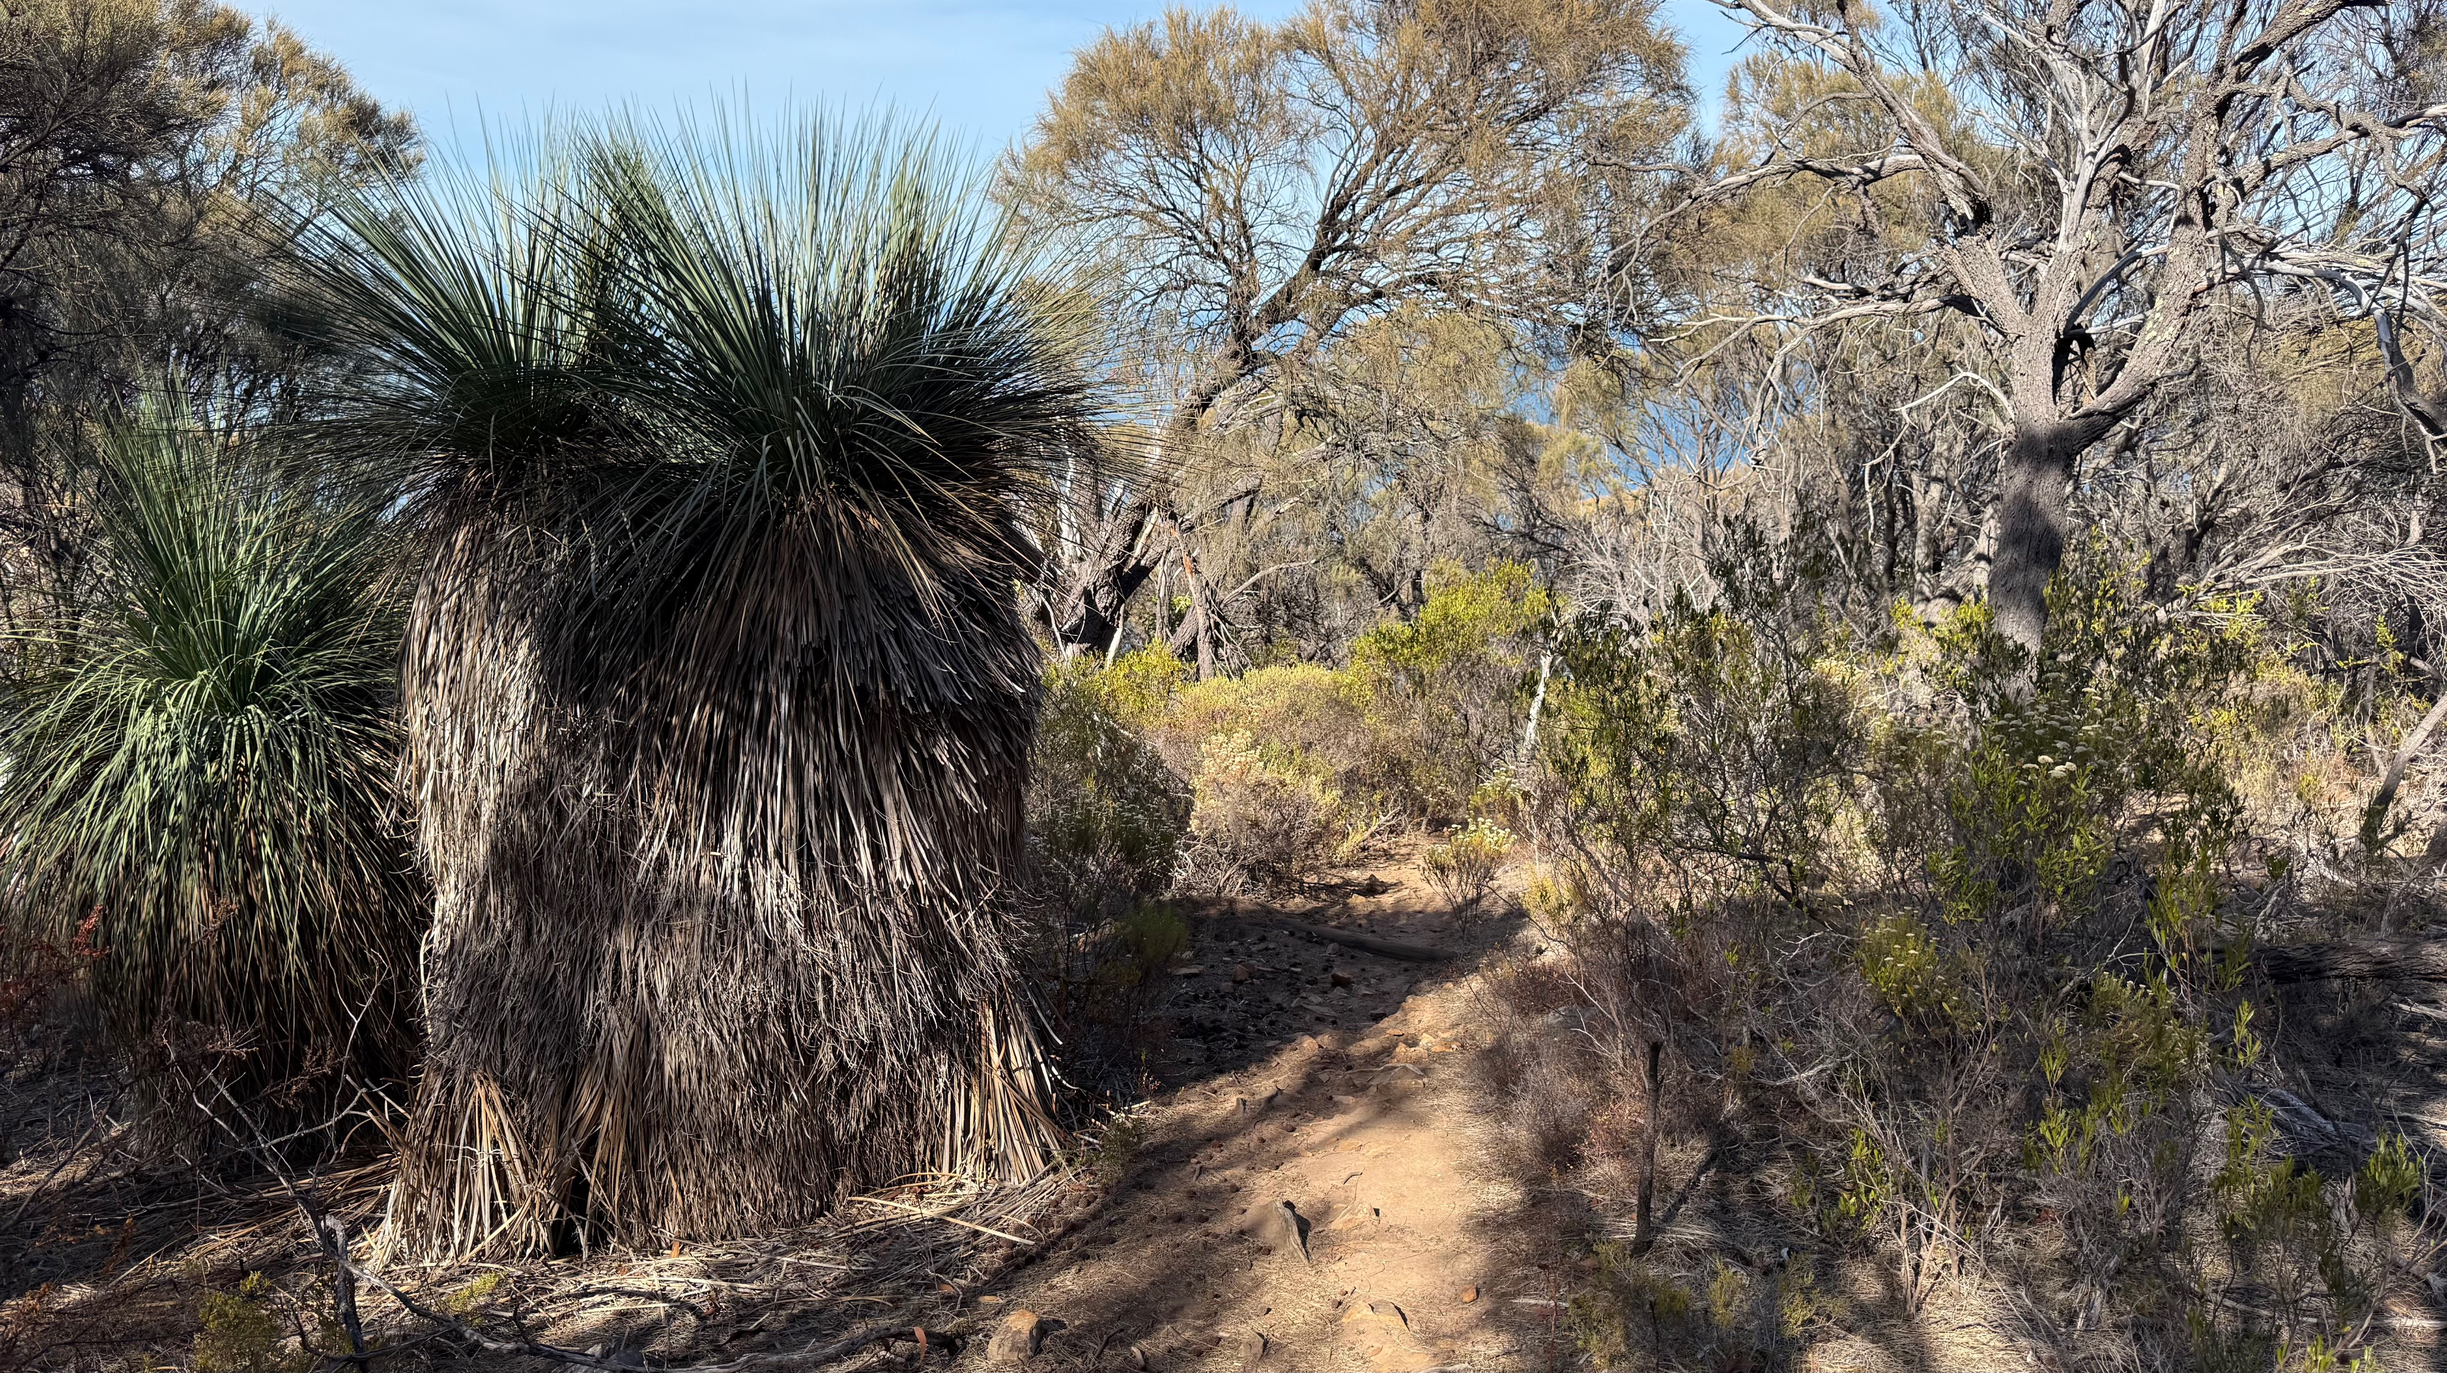
Thank you

Slide 27



Contact us
Evert Bleys
Co-Convenor
Standards Australia
+ 61 411 483 876
ejbleys@gmail.com
Peter Parslow
ISO/TC 211 Chair
Ordnance Survey
+44 7796 610020
peter.parslow@os.uk
Mats Åhlin
ISO/TC 211 Committee Manager
Swedish Institute for Standards
+46 8 555 520 53
mats.ahlin@sis.se
Christine Allansson
Committee support
Swedish Institute for Standards
+ 46 8 555 521 43
christine.allansson@sis.se
Standards are developed by the people who need them – that could mean you.
Technical committees include experts from both standards and industry and these experts are put forward by ISO’s national members.
If you want to help shape future standards in your field, contact your national member

Slide 28
Image Credits:
Legal aspects regarding image usage:
Provided by ISO/TC211, All rights reserved
Slides: 2; and 3 – Code of Ethics and Conduct
All other photos by Evert Bleys
Originals available for use within TC211 royalty free.
Slide 14, Oxford Bodleian library (2023-06-23)
Others Deep Creek National Park South Aust. (2025-03)

